Slide 1
Microsoft Power BI

Slide 2
Building Solutions using Power Automate and the Power BI REST APIs
Ted Pattison
Principal Program Manager
Power BI Customer Advisory Team (PBICAT)

Slide 3
Welcome to Power BI Dev Camp
Power BI Dev Camp Portal - https://powerbidevcamp.net

Slide 4
Power-Automate-with-Power-BI - Developer Sample
https://github.com/PowerBiDevCamp/Power-Automate-with-Power-BI

Slide 5
Sample Power Platform Solution
Sample solution: Power Automate with Power BI Demo
Can be downloaded from GitHub repo as a ZIP archive
Can be imported into Power Platform environment with Dataverse

Slide 6
Power Automate with Power BI Demo Solution
Canvas apps
Cloud flows
Custom connectors

Slide 7
Agenda
Creating a Power Platform Custom Connector
Calling the Power BI REST API from Canvas Apps
Calling the Power BI REST API from Flows
Automating Administrative Tasks using Power BI Admin APIs

Slide 8
Introduction to Power Platform Custom Connectors not to be confused Power BI custom connectors
Enables Canvas Apps and Flows to call operations on custom web APIs
Custom connector defines actions which map to web API operations
Each operations includes details for calling one web API endpoint
Abstracts away details of acquiring access token for current user
Provides support for managing user credentials and hiding secrets

Slide 9
Creating a Custom Connector
Power Platform supplies custom connector editor
Can be used to create custom connector from scratch
Custom connectors can be imported from various formats
Custom connectors can be exported and imported in JSON file format

Slide 10
Configuring Authentication for Custom Connector
Custom connectors support several kinds of authentication
Authentication is supported for users but not for service principals
Use OAuth 2.0 support for Azure Active Directory to call Power BI Service API
Requires creating Azure Active Directory application and configuring delegated permissions

Slide 11
Creating Azure AD Applications for Custom Connectors
You must create Azure AD application to call Power BI Service API
Azure AD application needs an app secret
Azure AD application needs to be configured with delegated permissions

Slide 12
Configuring Azure AD Application with Delegated Permissions
Configure your AAD application with delegated permissions you require
Different Power BI REST API calls require different permissions – figure out what you need
Optionally click Grant admin consent to eliminate consent prompt for users

Slide 13
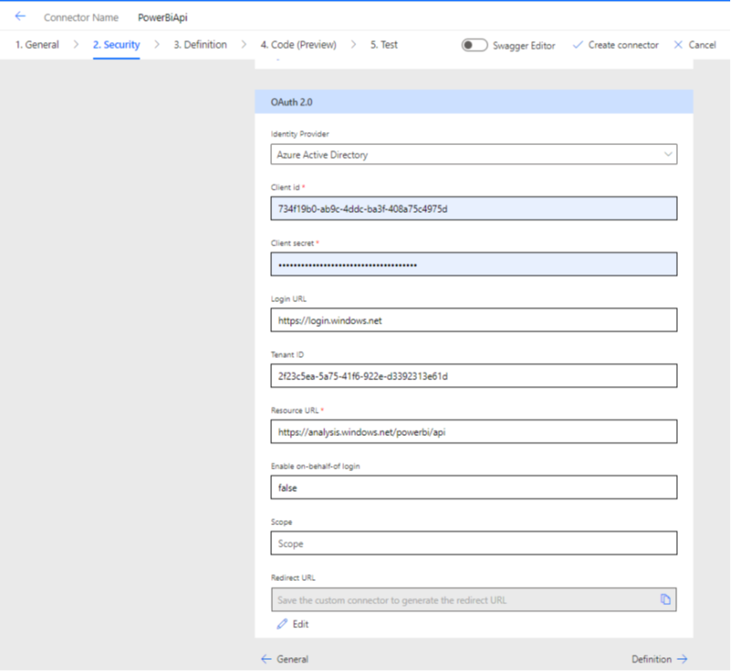
Power BI REST API Security Settings
Resource
https://analysis.windows.net/powerbi/api
Scope
Leave that textbox empty
.default used by default
Redirect URL
Leave blank
This will be added when you save connector

Slide 14
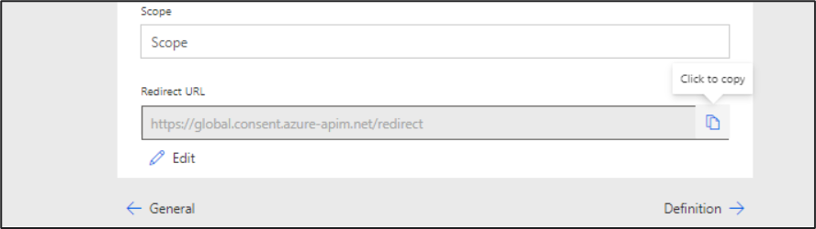
Power Platform Generates the Redirect URI
After you save the connector, the Redirect URL is assigned a value
Return to Azure AD portal and update Azure AD application with Redirect URL

Slide 15
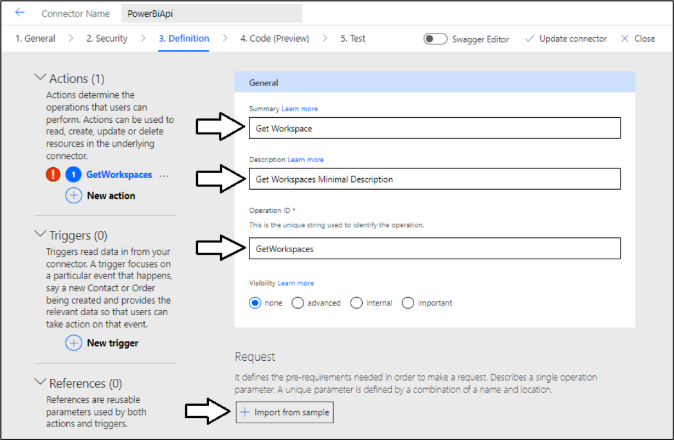
Creating a New Action
Go to Definition tab and click New action
Creating a new Action

Slide 16
Power BI REST API Documentation
Leverage the Microsoft Docs for the Power BI REST API
https://docs.microsoft.com/en-us/rest/api/power-bi/

Slide 17
Request - Import from sample
Verb – HTTP verb such as GET, POST, PUT, PATCH & DELETE
URL – endpoint which can contain Path parameters and Query parameters
Headers – headers sent with request
Body – HTTP request body usually sent in JSON format

Slide 18
Understanding Path Parameters
URLs can contain path parameters (e.g., WorkspaceId and DatasetId
https://api.powerbi.com/v1.0/myorg/groups/{WorkspaceId}/datasets/{DatasetId}
Path parameters are seen a required parameters when called from canvas app or flow

Slide 19
Response – Import from Sample
Response definition used to convert JSON into object
Import from sample provides quick way to create response definition

Slide 20
Creating Custom Connectors using the Swagger Editor
Custom Connector editor includes Swagger Editor
Make it possible to directly edit or copy-and-paste action definitions

Slide 21
Agenda
Creating a Power Platform Custom Connector
Calling the Power BI REST API from Canvas Apps
Calling the Power BI REST API from Flows
Automating Administrative Tasks using Power BI Admin APIs

Slide 22
Sample Canvas App – Workspace Manager

Slide 23
Dataset Details Page

Slide 24
Calling a Custom Connector Action from a Flow

Slide 25
Agenda
Creating a Power Platform Custom Connector
Calling the Power BI REST API from Canvas Apps
Calling the Power BI REST API from Flows
Automating Administrative Tasks using Power BI Admin APIs

Slide 26
Executing a Flow from a Canvas App – Part 1
Create Flow with PowerApps (V2) trigger
This allows you to pass parameters from canvas app to flows

Slide 27
Executing a Flow from a Canvas App – Part 2
Called using FlowName.Run() syntax
Canvas app can pass parameters defined in flow trigger

Slide 28
Calling the Power BI REST API as Service Principal
Custom connector do not support service principal authentication
Alternative is to obtain SP access token directly use it to call PBI REST API
SP access token acquired with Client Credentials Flow with HTTP action
PBI REST API calls executed using HTTP action which include access token

Slide 29
Implementing Client Credentials Flow with HTTP Action

Slide 30
Example API Call - Importing PBIX using the HTTP Action

Slide 31
Waiting for Import to Complete

Slide 32
Updating Parameters and Setting Datasource Credentials

Slide 33
Agenda
Creating a Power Platform Custom Connector
Calling the Power BI REST API from Canvas Apps
Calling the Power BI REST API from Flows
Automating Administrative Tasks using Power BI Admin APIs

Slide 34
Calling GetGroupsAsAdmin
Heavy-weight API call to retrieve tenant inventory of workspaces and their contents
Can pass $filter parameters with optimized filters such as "-type" and "-state“
Can pass $expand parameter with users , datasets, reports, dashboards, dataflows
GetGroupsAsAdmin calls limited to 30 seconds or they timeout
GetGroupsAsAdmin API limited to 50 calls per hour

Slide 35
Sample Canvas App – Power BI Asset Auditor

Slide 36
Designing a Flow to Scan a Workspace
PostWorkspaceInfo scan far more scalable than GetGroupsAsAdmin
More complex to use due to asynchronous programming pattern

Slide 37
Extracting Data from the Power BI Activity Log
Allows for extraction of Power BI activity event data
Requires programming paginated API results using continuation token

Slide 38
Summary
Creating a Power Platform Custom Connector
Calling the Power BI REST API from Canvas Apps
Calling the Power BI REST API from Flows
Automating Administrative Tasks using Power BI Admin APIs

Slide 39
Agenda
Creating a Power Platform Custom Connector
Calling the Power BI REST API from Canvas Apps
Calling the Power BI REST API from Flows
Automating Administrative Tasks using Power BI Admin APIs

Slide 40
Microsoft Power BI
Questions?

